Slide 1



World Analysis Presentation

Slide 2
Introduction
MY DATA SET NAME: Word-Data-2023
THE LINK: https://www.kaggle.com/datasets/nelgiriyewithana/countries-of-the-world-2023?
THE MOST IMPORTANT COLUMNS:
COUNTRY
GDP
CO2 EMISSION
BIRTH RATE
UNEMPLOYMENT RATE
INFANT MORTALITY
LIFE EXPECTANCY
MINIMUM WAGE
POPULATION

Slide 3
MY QUESTIONS
Which countries have the highest GDP?
The top 20 with highest CO2 emissions
The top countries collect the highest tax revenue.
Birth vs GDP
Infant mortality by countries vs Life expectancy
What is the relationship between CPI and Minimum wage?
Which countries have the highest armed forces size?
Which countries have the highest and the lowest Unemployment rate?

Slide 4
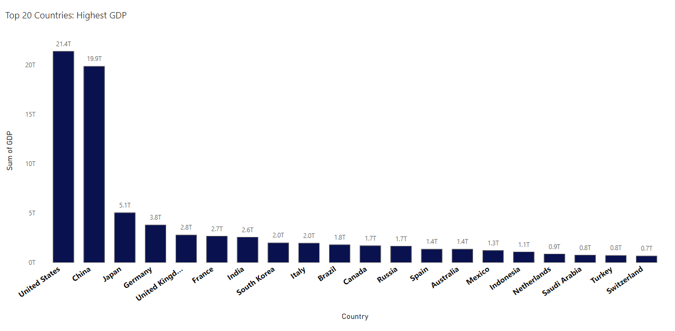
MY ANSWERS
Which countries have the highest GDP?
Open in Power BI dashboardfinal Data as of 9/27/24, 9:46 PM Filtered by Country (top 20 by GDP)

Slide 5
Insights
A bar graph illustrates their GDP values, ranging from billions to trillions, showcasing leading economies. The bar plot visualizes the top 20 countries with the highest Gross Domestic Product (GDP). The United States leads with the highest GDP, followed by China, Germany, and the United Kingdom, showcasing their significant economic strength. The graph offers a clear comparison of GDP values among these countries.

Slide 6
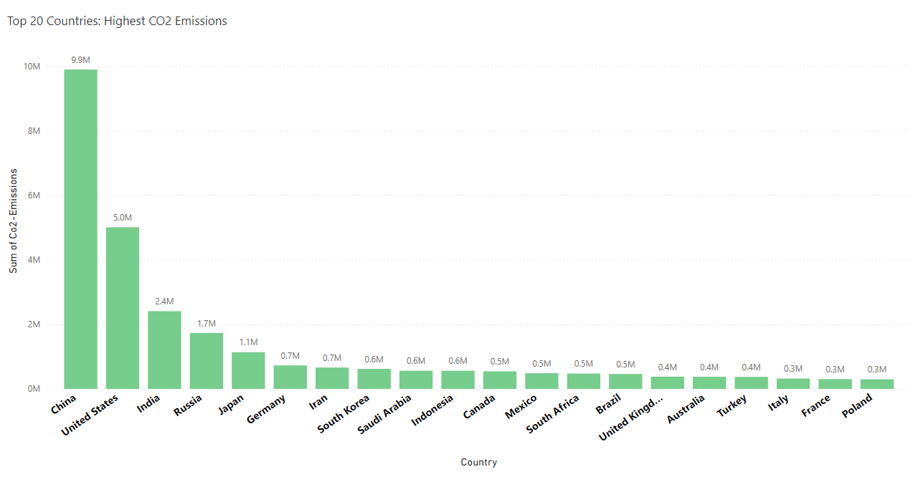
The top 20 with highest CO2 emissions
Open in Power BI dashboardfinal Data as of 9/27/24, 9:46 PM Filtered by Country (top 20 by Co2-Emissions)

Slide 7
Insights
The bar plot showcases the top 20 countries with the highest CO2 emissions. China has the highest CO2 emissions, followed by the United States and India. This visualization highlights these countries' significant carbon dioxide emissions, indicating their impact on global environmental concerns such as climate change and means that they are Industrialized countries.

Slide 8
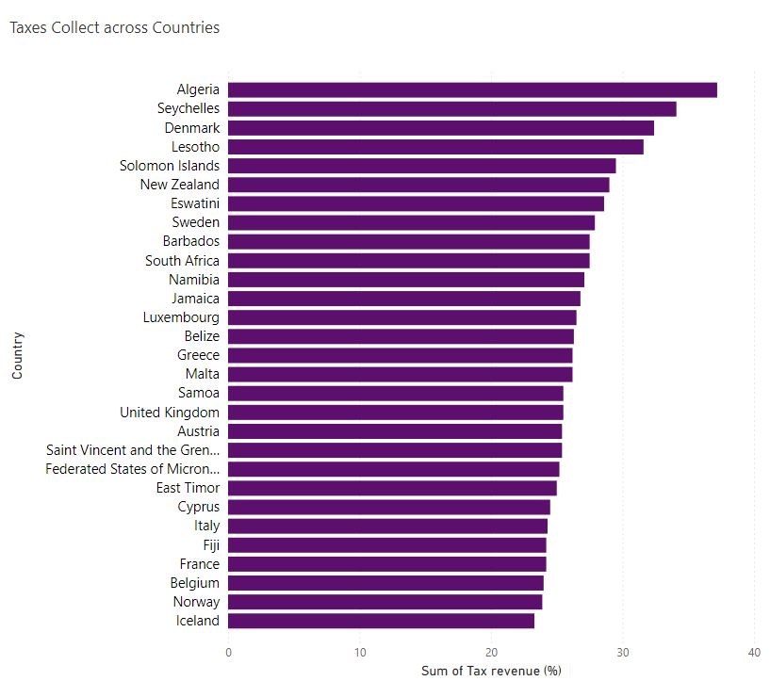
The top countries collect the highest tax revenue.
Open in Power BI dashboardfinal Data as of 9/27/24, 9:46 PM

Slide 9
Insights
A bar graph showcases which countries collect the largest tax in the world like Algeria with 37.20% followed by Seychelles with 34.10% while the lowest is the United Arab Emirates with 0.10% This type of chart allows for a clear comparison across countries, highlighting those with the highest and lowest tax revenues.

Slide 10

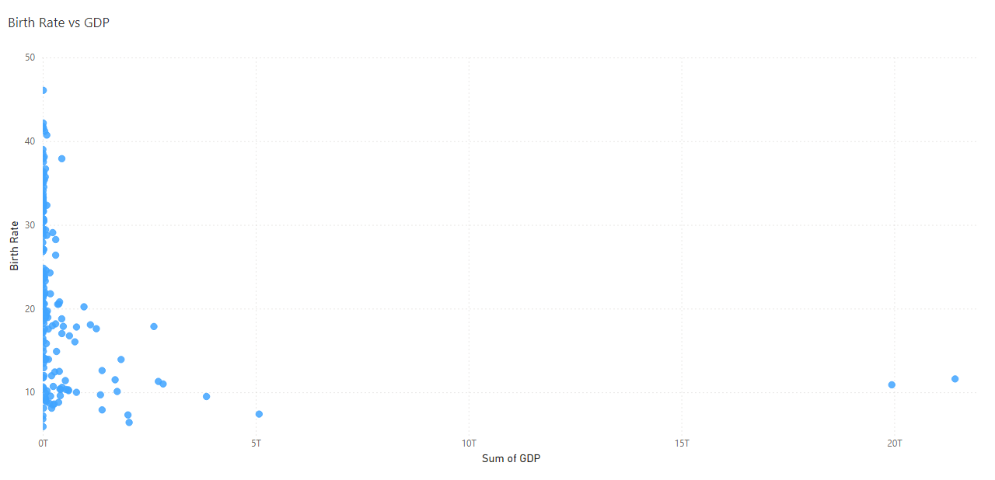
Birth vs GDP
Open in Power BI dashboardfinal Data as of 9/27/24, 9:46 PM

Slide 11
Insights
This pattern demonstrates how wealthier countries, with higher GDPs, often have lower birth rates due to advanced healthcare, higher education, and economic factors, while countries with lower GDPs tend to have higher birth rates driven by socio-economic and developmental challenges
United States: With a GDP of $21.4 trillion and a birth rate of 11.60 births per 1,000 people, the U.S. reflects the trend seen in wealthier, developed nations—lower birth rates due to factors like higher education, better access to healthcare, and a focus on smaller family sizes.
South Africa: On the other hand, with a GDP of $12 billion and a birth rate of 46.08 births per 1,000 people, South Africa highlights the trend in many lower-income countries where higher birth rates are common. This can be attributed to limited access to family planning, lower education levels, and economic reliance on larger families.

Slide 12
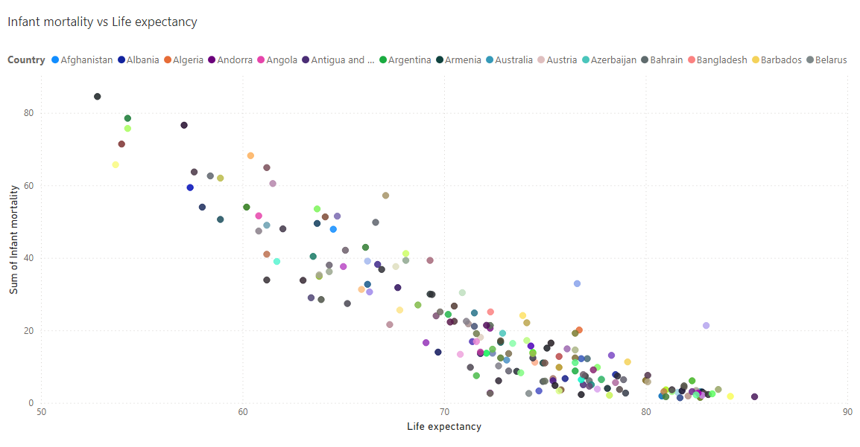
Infant mortality by countries vs Life expectancy.
Open in Power BI dashboardfinal Data as of 9/27/24, 9:46 PM

Slide 13
Insights
The comparison between Infant Mortality and Life Expectancy in countries highlights significant disparities in healthcare, development, and living conditions:
In the Central African Republic, where life expectancy is 52.80 years and infant mortality is 84.50 deaths per 1,000 live births, the high infant mortality rate indicates poor healthcare access, inadequate maternal and infant care, and overall lower living standards. This reflects the country's economic struggles, limited infrastructure, and persistent poverty, contributing to lower life expectancy.
In contrast, San Marino, with a life expectancy of 85.40 years and infant mortality of only 1.70 deaths per 1,000 live births, benefits from a strong healthcare system, advanced medical facilities, and higher living standards. These factors contribute to longer lifespans and far fewer infant deaths.

Slide 14
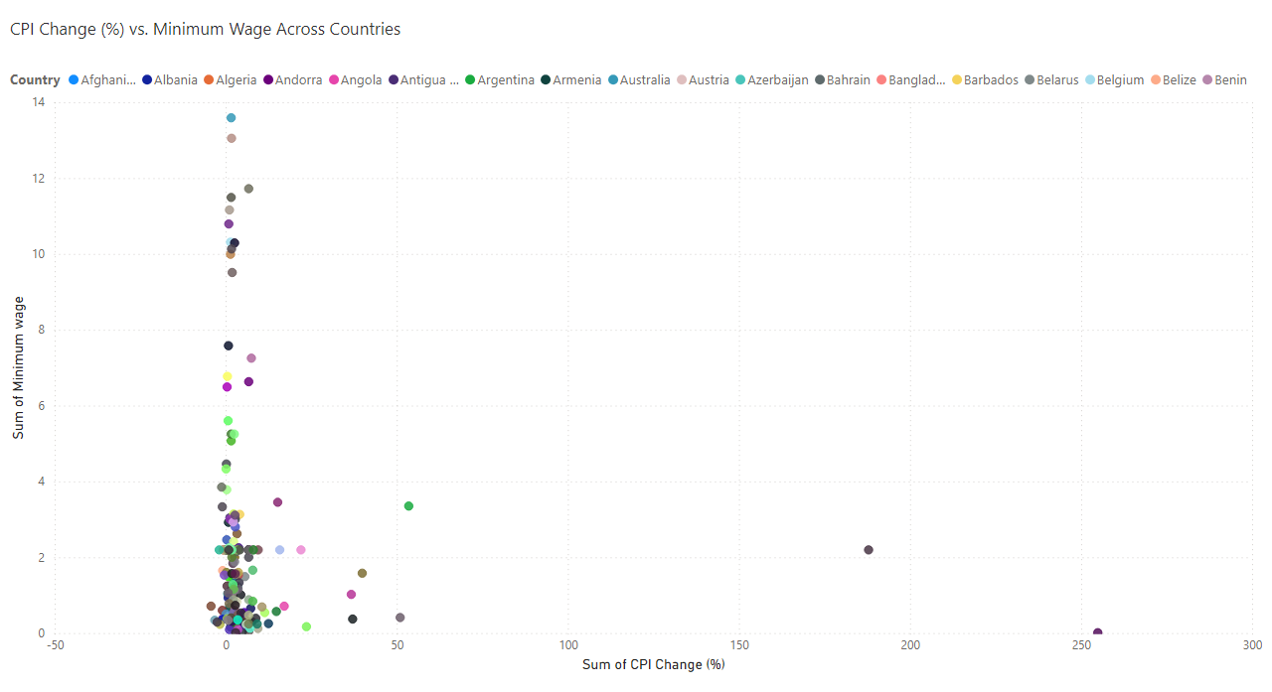
What is the relationship between CPI and Minimum wage?
Open in Power BI dashboardfinal Data as of 9/27/24, 9:46 PM

Slide 15
Insights
The comparison between CPI (Consumer Price Index) and Minimum Wage for countries like Australia and Venezuela highlights key differences in economic stability, inflation, and wage policies:
Australia With a CPI of 1.60 (indicating low inflation) and a minimum wage of 13.59, Australia demonstrates economic stability and a strong policy for ensuring adequate wages relative to the cost of living. The low CPI suggests that prices for goods and services are relatively stable, and the high minimum wage helps maintain living standards.
Venezuela: In contrast, Venezuela’s CPI of 254.90 (indicating extreme inflation) and minimum wage of 0.01 highlight a severe economic crisis. Hyperinflation drastically reduces the purchasing power of wages, rendering the minimum wage almost worthless in real terms. This reflects the country's deep economic instability, where wages have not kept pace with runaway inflation.

Slide 16
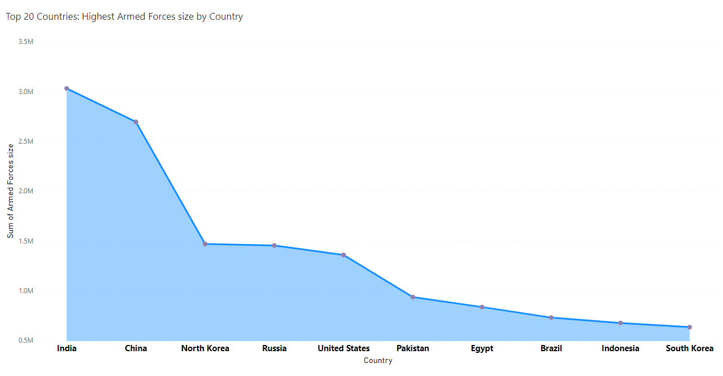
Which countries have the highest armed forces size?
Open in Power BI dashboardfinal Data as of 9/27/24, 9:46 PM Filtered by Country (top 10 by Armed Forces size)

Slide 17
Insights
The chart shows the sizes of the armies in the top 10 countries. India has the biggest army, followed by China, Russia, the United States, and Pakistan. This graph helps us see how different these countries' armies are. And they have great security stability

Slide 18
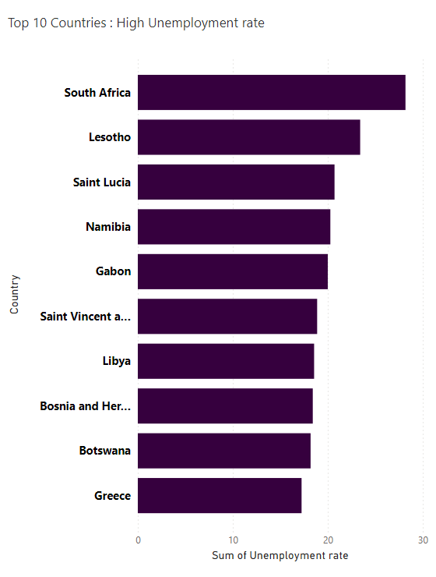
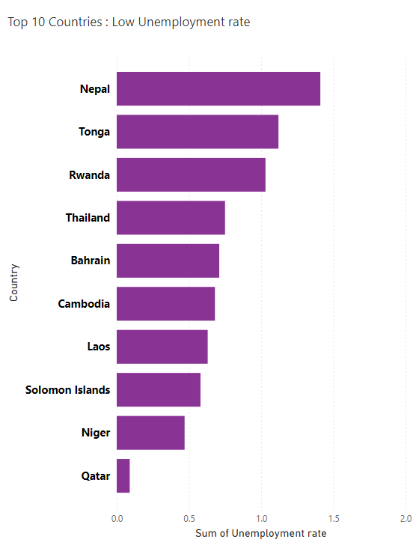
Which countries have the highest and the lowest Unemployment rate?
Open in Power BI dashboardfinal Data as of 9/27/24, 9:46 PM Filtered by Country (bottom 10 by Unemployment rate)
Open in Power BI dashboardfinal Data as of 9/27/24, 9:46 PM Filtered by Country (top 10 by Unemployment rate)

Slide 19
Insights
The comparison of the Top 10 Countries with the Highest and Lowest Unemployment Rates provides insight into global economic disparities:
Countries with the Highest Unemployment Rates: South Africa leads with an unemployment rate of 28.18%, followed by Lesotho and Saint Lucia, indicating severe economic challenges and limited job opportunities. The presence of the United States on this list reflects short-term fluctuations due to economic shocks or specific labor market conditions.
Countries with the Lowest Unemployment Rates: Nations like Qatar, Niger, Solomon Islands, and Laos have unemployment rates as low as less than 1%. These low rates are often attributed to smaller populations, niche economies, or strong labor market structures

Slide 20
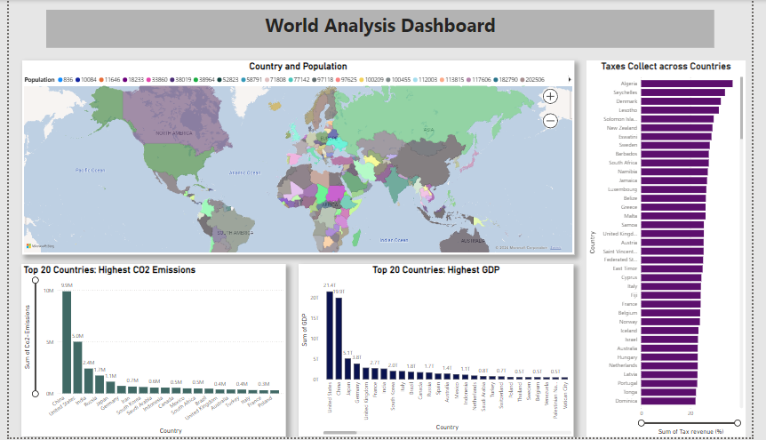

Slide 21
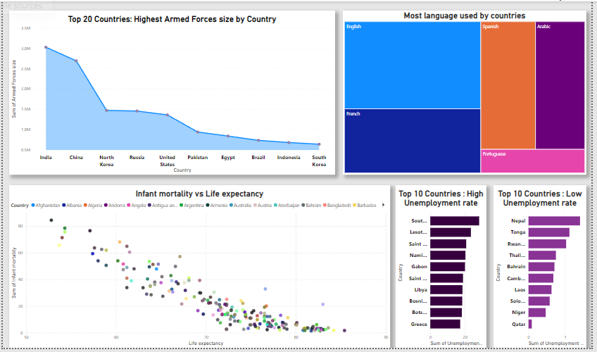

Slide 22
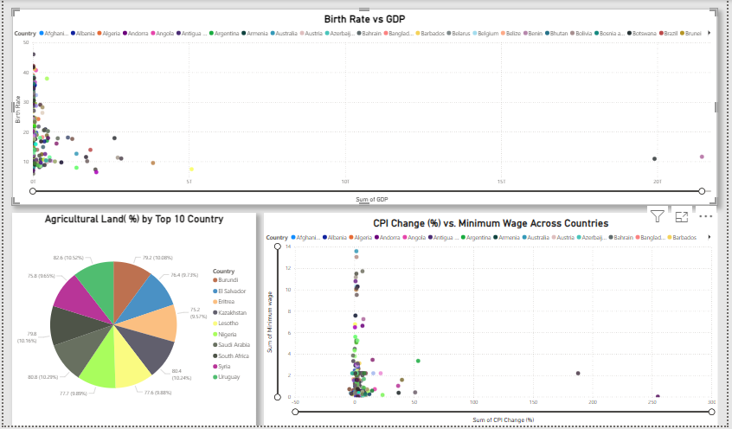

Slide 23
Thank you

